Slide 1
Modifying Layer Activations
Landon Buell
2 April 2020

Slide 2
The Problem
How does changing Layer Activations affect the performance of a Multi-Layer Perceptron Classifier?

Slide 3
Layer Activations
Simulate approximate computations
Simulate behavior on ‘New’ activation functions
Analyze what problem may arise
Analyze what solutions may arise
What happens when we manipulate the activations?

Slide 4

MLP Classifier Architecture
Series of Repeated Matrix – Vector Products (Geron)
$${\vec{x}}^{(l+1)}=f[ {\hat{W}}^{\left(l\right)}{\vec{x}}^{\left(l\right)}+{\vec{β}}^{(l)}]$$
This is the general process for forward propagation (Sanderson)

Slide 5
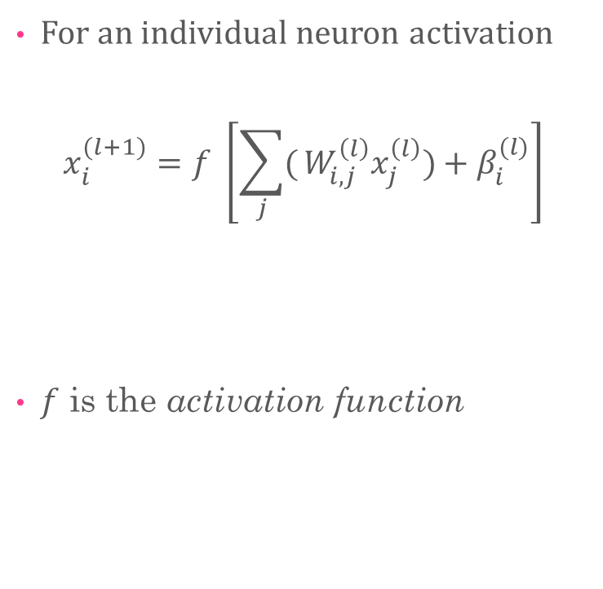
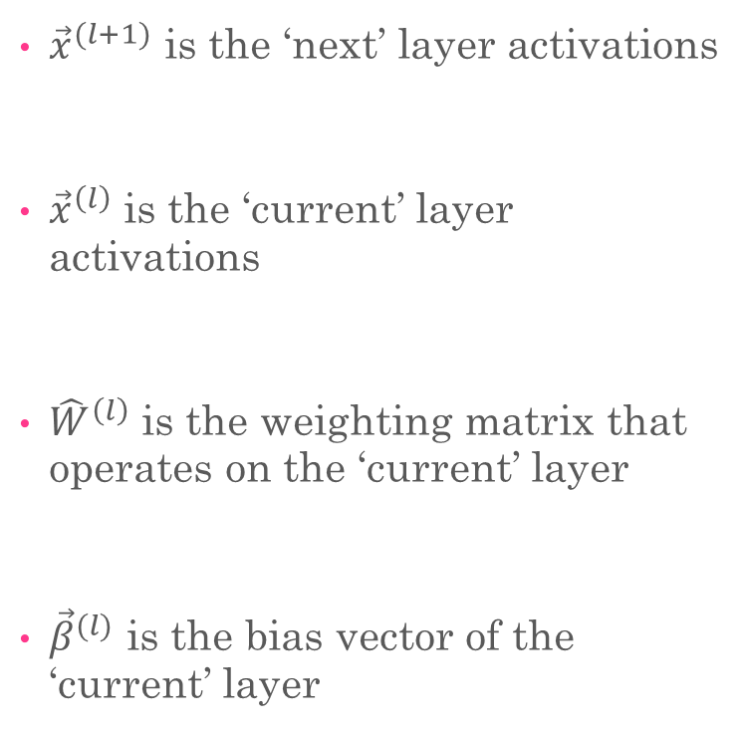
Conventions
${\vec{x}}^{(l+1)}$ is the ‘next’ layer activations
${\vec{x}}^{\left(l\right)}$ is the ‘current’ layer activations
${\hat{W}}^{\left(l\right)}$ is the weighting matrix that operates on the ‘current’ layer
${\vec{β}}^{(l)}$ is the bias vector of the ‘current’ layer
For an individual neuron activation
$$x_{i}^{(l+1)}=f \left[\sum_{j}{(}W_{i,j}^{\left(l\right)}x_{j}^{\left(l\right)})+β_{i}^{(l)}\right]$$
$f$ is the activation function

Slide 6

Quick Example
MLP with two hidden layers:
$${\vec{x}}^{\left(3\right)}=f\left[{\hat{W}}^{2} f\left[{\hat{W}}^{1} f\left[ {\hat{W}}^{0}{\vec{x}}^{0}\right]+{\vec{β}}^{0}\right]+{\vec{β}}^{1}\right]+{\vec{β}}^{2}]$$
Recall ${\vec{x}}^{0}$ is the input feature vector
Original data given to a model
Recall ${\vec{x}}^{3}$is the final output of the model

Slide 7
Forward Pass
The core operation is matrix multiplication
Vector additional is also used
Activation functions act on the resultant linear combination
What happens when we manipulate the output of matrix multiplication?

Slide 8
Experimental Setup
Creating the Models

Slide 9
Experimental Data Set
MNIST Data Set
784 Input Features – 10 Output Classes
Use first 10,000 sample for training
Next 5,000 samples for evaluation

Slide 10
Creating Models
Model Number | Output Layer Size | Layer 3 Size | Layer 3 Size | Layer 2 Size | Layer 1 Size | Input Layer Size
1 | 10 | - | - | - | - | 784
2 | 10 | - | - | - | 20 | 784
3 | 10 | - | - | - | 100 | 784
4 | 10 | - | - | 20 | 20 | 784
5 | 10 | - | - | 100 | 100 | 784
6 | 10 | 20 | 20 | 20 | 20 | 784

Slide 11
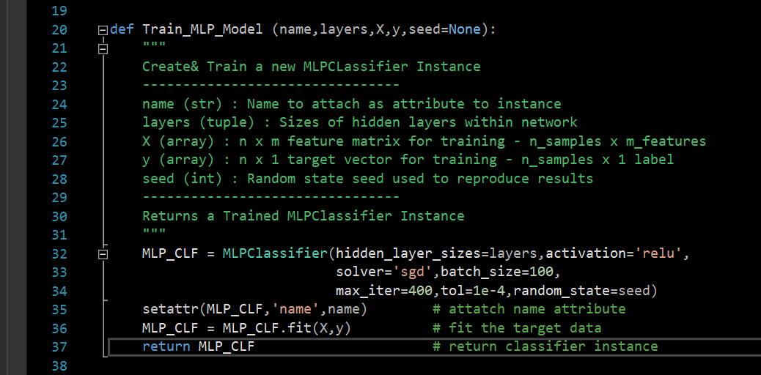
Creating Models
We create and train a series of Neural Network Models
Set Common Hyperparameters
ReLU Activation Function
Stochastic Gradient Descent
100 Sample Minibatch Size
400 Iterations Maximum
0.0001 Tolerance
New random state each iteration

Slide 12
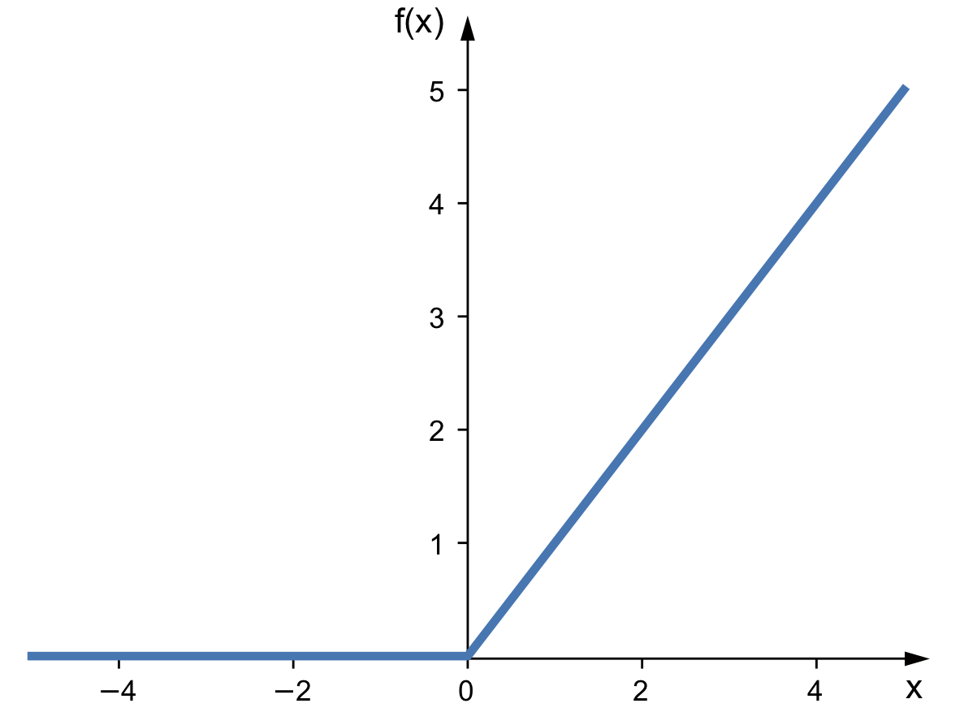
ReLU Activation Function
Rectified Linear Unit

Slide 13
Data From Each Model
Name of Model , Training Time , Layer Sizes , Loss Function value , Iterations to train (5 values)
Precision / Recall Scores from each class (20 values)
All 100 elements from standard confusion matrix
125 samples from each model

Slide 14
Experimental Results
Creating, Training & Testing the Models

Slide 15
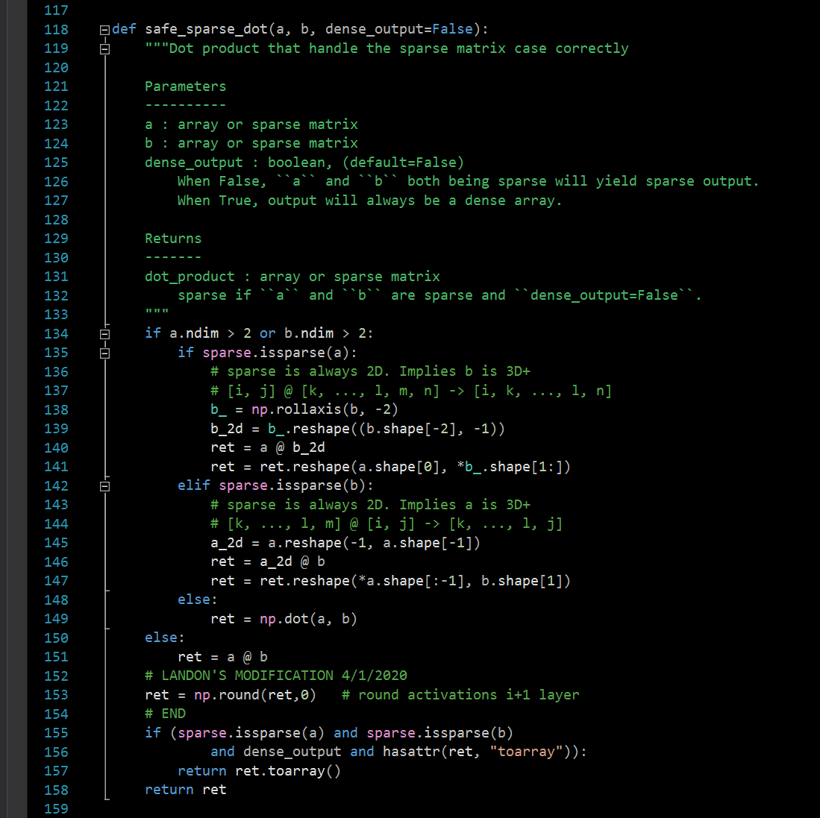
The First Modification
Change Matrix Multiplication
(Round to 0 decimals)
This represents an attack at a very low level
Changes forward pass equation
Will not be accounted for in Back propagation?

Slide 16
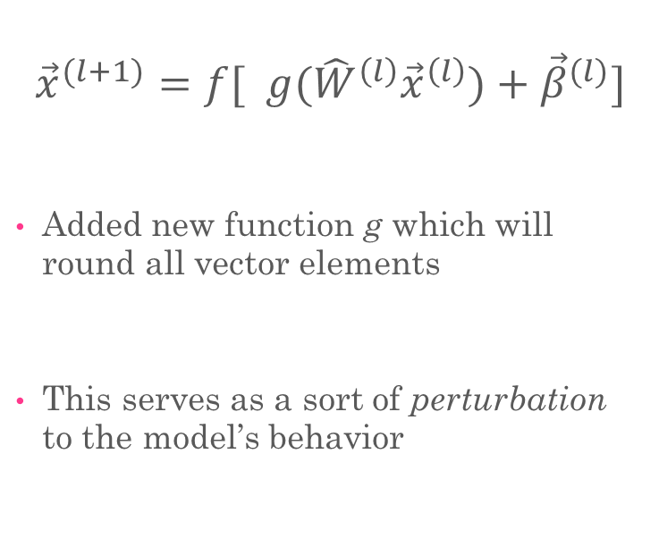
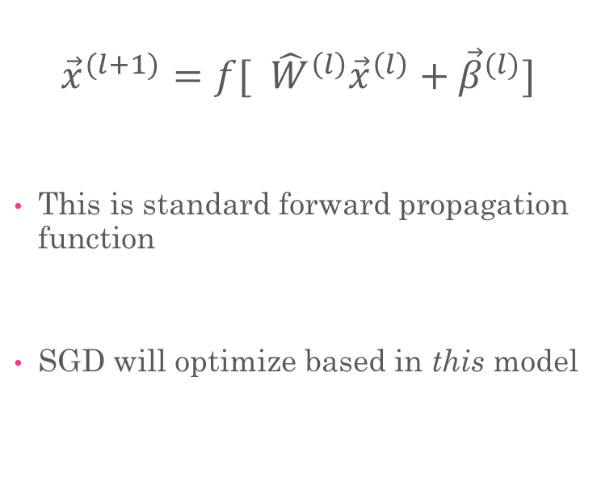
Behavior of New Model
Original Forward Pass
New Forward Pass
$${\vec{x}}^{(l+1)}=f[ {\hat{W}}^{\left(l\right)}{\vec{x}}^{\left(l\right)}+{\vec{β}}^{(l)}]$$
This is standard forward propagation function
SGD will optimize based in this model
$${\vec{x}}^{(l+1)}=f[ g({\hat{W}}^{\left(l\right)}{\vec{x}}^{\left(l\right)})+{\vec{β}}^{(l)}]$$
Added new function g which will round all vector elements
This serves as a sort of perturbation to the model’s behavior

Slide 17
Physical Implications
This physically represents a low-level attack
An “Always On” model
Matrix product changed:
Originally (usually) 16 decimal accuracy
Now, 0 decimals saved
An attack that reduces the numerical accuracy of a program

Slide 18
Control vs. Modified Model
Model | Control Train Time | Modified Train Time | Control Loss | Modified Loss | Control Iterations | Modified Iterations
(0) | 28.215625 | 46.407344 | - | - | 197.680000 | 197.680000
(20) | 19.716250 | 12.370313 | 1.940023 | 2.413378 | 88.980000 | 39.280000
(100) | 88.450312 | 34.03 | 0.230807 | - | 128.210000 | 27.75
(20,20) | 24.361406 | 16.019219 | 1.746305 | 2.365948 | 106.460000 | 40.830000
(100,100) | 132.63171 | 58.947344 | 0.485113 | - | 159.600000 | 36.980000
(20,20,20,20) | 49.611094 | 24.362344 | 0.518293 | 2.305293 | 178.240000 | 44.560000
Average time to train , Loss function values & iterations to train
All Values Averaged across 100 instances
‘-’ indicated ‘inf’ as returned by Python (unknown cause)

Slide 19
Control vs. Modified Model
Model | Control Precision | Modified Precision | Control Recall | Modified Recall
(0) | 0.858712 | 0.859069 | 0.856789 | 0.857029
(20) | 0.165242 | 0.158758 | 0.211598 | 0.139739
(100) | 0.855230 | 0.741226 | 0.845842 | 0.703482
(20,20) | 0.226885 | 0.102349 | 0.285867 | 0.127776
(100,100) | 0.736892 | 0.477699 | 0.739866 | 0.426414
(20,20,20,20) | 0.715778 | 0.120012 | 0.726083 | 0.148764
Average Precision & Recall Scores
All Values Averaged across 100 instances

Slide 20

Notes on Time Complexity (See sklearn Neural Networks page)
Rounding to nearest integer improves the time performance of the model?
General time complexity
$$𝒪(n⋅m⋅h^{k}⋅o⋅i)$$
n is number of training samples (10,000)
m is number of features (784)
h is number of neurons (per hidden layer)
k is number of hidden layers
o is number of output neurons (10)
i is number of iterations (400 at maximum)
By only saving the integer portion of a floating-point number, the algorithms seems to be faster

Slide 21
Some Conclusions From this Model
With more complex models, training time reduces
Less information to use in matrix multiplication?
Dramatically affects the performance of classifier model
Compounding error reduces the validity of ‘fit’
Based on these factors, an attack to this operation could be ‘noticed’

Slide 22
The Next Modifications
The Weighting Matrices & Bias Vectors, Introducing Random Noise

Slide 23
Variations of Current Model
Abandon the “always on” - randomly decide when to round
Round to different number of decimals
Change floating-point precisions (tougher in python)
Different round methods (floor, ceiling, etc.)

Slide 24
Modifying Weighting Matrices
Stored locally, and can be exported
Activation values are only useful for a single pass, then discarded
Error in the weighting matrices will compound
Values are iteratively updated by SGD procedure
How does adding small perturbations after each pass change the performance?

Slide 25
Introducing Random Noise
At designated places, we can introduce “noise”
Add or subtract floating point values
Typically drawn from Gaussian Curve
Most common way to model noise (James)

Slide 26
Refrences
Geron, Aurelien. Hands-on Machine Learning with Scikit-Learn and TensorFlow: Concepts, Tools, and Techniques to Build Intelligent Systems. O’Reilly, 2017.
James, Gareth, et al. An Introduction to Statistical Learning with Applications in R. Springer, 2017.
Sanderson, Grant. But What Is A Neural Network? 3Blue1Brown, www.3blue1brown.com/neural-networks.

